Slide 1
1 Thessalonians 4:9-5:2
a cd of this message will be available (free of charge) immediately following today’s service
a podcast will be available later in the week at calvaryokc.com
This Photo by Unknown Author is licensed under CC BY-SA

Slide 2
Gen. 6:5-6 ~ ⁵ Then the Lord saw that the wickedness of man was great in the earth, and that every intent of the thoughts of his heart was only evil continually. ⁶ And the Lord was sorry that He had made man on the earth, and He was grieved in His heart.
Luke 17:26 ~ And as it was in the days of Noah, so it will be also in the days of the Son of Man …
1 Thessalonians 4:9-5:2

Slide 3
1 Thessalonians 4:9-5:2

Slide 4
And a Happy New Year
Buy your
own gift.
Love,
Annabelle
1 Thessalonians 4:9-5:2

Slide 5
1 Thessalonians 4:9-5:2

Slide 6
1 Thess. 4:9–5:2 ~ ⁹ But concerning brotherly love you have no need that I should write to you, for you yourselves are taught by God to love one another; ¹⁰ and indeed you do so toward all the brethren who are in all Macedonia. But we urge you, brethren, that you increase more and more; ¹¹ that you also aspire to lead a quiet life, to mind your own business, and to work with your own hands, as we commanded you,
1 Thessalonians 4:9-5:2

Slide 7
1 Thess. 4:9–5:2 ~ ¹² that you may walk properly toward those who are outside, and that you may lack nothing.
¹³ But I do not want you to be ignorant, brethren, concerning those who have fallen asleep, lest you sorrow as others who have no hope. ¹⁴ For if we believe that Jesus died and rose again, even so God will bring with Him those who sleep in Jesus.
1 Thessalonians 4:9-5:2

Slide 8
1 Thess. 4:9–5:2 ~ ¹⁵ For this we say to you by the word of the Lord, that we who are alive and remain until the coming of the Lord will by no means precede those who are asleep. ¹⁶ For the Lord Himself will descend from heaven with a shout, with the voice of an archangel, and with the trumpet of God. And the dead in Christ will rise first. ¹⁷ Then we who are alive and remain shall be caught
1 Thessalonians 4:9-5:2

Slide 9
1 Thess. 4:9–5:2 ~ up together with them in the clouds to meet the Lord in the air. And thus we shall always be with the Lord. ¹⁸ Therefore comfort one another with these words.
¹ But concerning the times and the seasons, brethren, you have no need that I should write to you. ² For you yourselves know perfectly that the day of the Lord so comes as a thief in the night.
1 Thessalonians 4:9-5:2

Slide 10
1 Thessalonians 4:9-5:2

Slide 11
Merriam-Webster ~ “the final assumption of Christians into heaven during the end-time according to Christian theology”
1 Thessalonians 4:9-5:2

Slide 12
1 Thessalonians 4:9-5:2

Slide 13
aspire ~ NIV, NASB – ambition – philotimeomai (to love honor)
KJV, study to be quiet
1 Thessalonians 4:9-5:2

Slide 14
1 Thessalonians 4:9-5:2

Slide 15
Cemetery ~ Latin “sleeping place”
1 Thessalonians 4:9-5:2

Slide 16
1 Thessalonians 4:9-5:2

Slide 17
caught up ~ harpazō – to catch, pluck take away (by force)
In Latin Vulgate ~ rapere
1 Cor. 15:52 ~ in a moment, in the twinkling of an eye, at the last trumpet. For the trumpet will sound, and the dead will be raised incorruptible, and we shall be changed.
moment ~ atomos – literally, uncut
1 Thessalonians 4:9-5:2

Slide 18
1 Thessalonians 4:9-5:2

Slide 19
1 Thessalonians 4:9-5:2

Slide 20
7-year Tribulation
Church Age
Millennium
Pre-trib
Post-trib
Mid-trib
Pre-wrath
A-millennialism
1 Thessalonians 4:9-5:2

Slide 21
1 Thessalonians 4:9-5:2

Slide 22
7-year Tribulation
Church Age
Millennium
The Rapture
Jesus coming for His Church
2nd Coming Jesus coming with His Church
Return of Christ
1 Thessalonians 4:9-5:2

Slide 23
Billy Sunday (1862-1935) ~ “The Lord does not come to the world at the time of the Rapture, but only reveals himself to the members of His Body. At the time of his resurrection He was only seen by those who believed on Him. Pilate and the High Priest, and those who crucified Him, did not know that He was risen. So it will be at the time of the Rapture.
1 Thessalonians 4:9-5:2

Slide 24
Billy Sunday (1862-1935) ~ The world will not know that He has been here, and will have no knowledge of Him until He comes with the members of His Body, at the close of the Tribulation.”
1 Thessalonians 4:9-5:2

Slide 25
1 Thessalonians 4:9-5:2

Slide 26
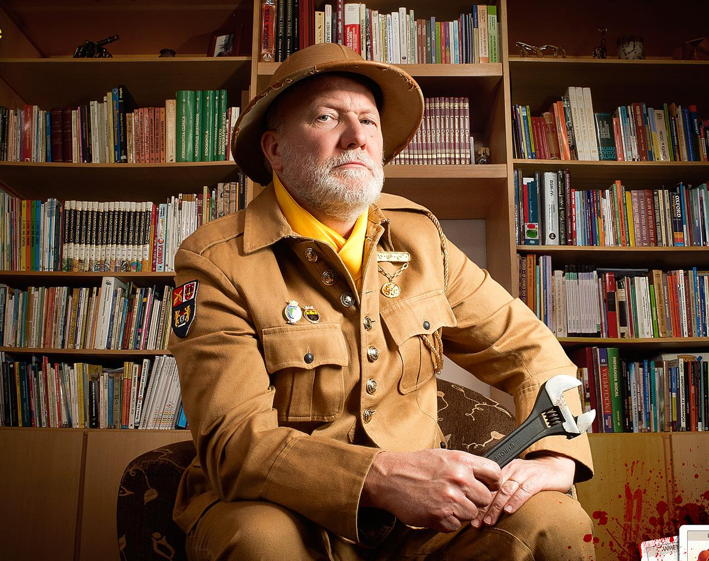
Library
Col. Mustard
CLUES
Wrench
1 Thessalonians 4:9-5:2

Slide 27
1 Thessalonians 4:9-5:2

Slide 28
Rapture Primer
An elementary textbook.
A book covering the basic elements of a subject.
1 Thessalonians 4:9-5:2

Slide 29
2 Reasons for the Tribulation:
Reveal Jesus as the Messiah to the Jews
Zech. 12:10 ~ And I will pour on the house of David and on the inhabitants of Jerusalem the Spirit of grace and supplication; then they will look on Me whom they pierced. Yes, they will mourn for Him as one mourns for his only son, and grieve for Him as one grieves for a firstborn.
1 Thessalonians 4:9-5:2

Slide 30
2 Reasons for the Tribulation:
Judge the world for rejecting Him
Rev. 6:15-17 ~ ¹⁵ And the kings of the earth, the great men, the rich men, the commanders, the mighty men, every slave and every free man, hid themselves in the caves and in the rocks of the mountains, ¹⁶ and said to the mountains and rocks, “Fall on us and hide us from the face of Him who sits on the throne and from the wrath of the Lamb! ¹⁷ For the great day of His wrath has come, and who is able to stand?”
1 Thessalonians 4:9-5:2

Slide 31
18 Reasons for a
Pre-tribulation Rapture of the Church
1 Thessalonians 4:9-5:2

Slide 32
18 Reasons for a
Pre-tribulation Rapture of the Church
1) Lot (Gen. 19)
2 Pet. 2:9 ~ then the Lord knows how to deliver the godly out of temptations and to reserve the unjust under punishment for the day of judgment,
1 Thessalonians 4:9-5:2

Slide 33
18 Reasons for a
Pre-tribulation Rapture of the Church
2) Rahab (Joshua 6)
Josh. 6:17 ~ Now the city shall be doomed by the LORD to destruction, it and all who are in it. Only Rahab the harlot shall live, she and all who are with her in the house, because she hid the messengers that we sent.
1 Thessalonians 4:9-5:2

Slide 34
18 Reasons for a
Pre-tribulation Rapture of the Church
3) Daniel (Dan. 3)
Daniel is absent from the “tribulation” of Shadrach, Meshach and Abed-Nego
1 Thessalonians 4:9-5:2

Slide 35
18 Reasons for a
Pre-tribulation Rapture of the Church
4) Is. 57:1 ~ The righteous perishes,
And no man takes it to heart;
Merciful men are taken away, While no one considers
That the righteous is taken away from evil.
1 Thessalonians 4:9-5:2

Slide 36
18 Reasons for a
Pre-tribulation Rapture of the Church
5) Not appointed unto wrath
1 Thess. 5:9-11 ~ ⁹ For God did not appoint us to wrath, but to obtain salvation through our Lord Jesus Christ, ¹⁰ who died for us, that whether we wake or sleep, we should live together with Him. ¹¹ Therefore comfort each other and edify one another, just as you also are doing.
1 Thessalonians 4:9-5:2

Slide 37
18 Reasons for a
Pre-tribulation Rapture of the Church
6) 1 Cor. 12:27 ~ Now you are the body of Christ, and members individually.
1 Thessalonians 4:9-5:2

Slide 38
18 Reasons for a
Pre-tribulation Rapture of the Church
7) 1 Thess. 5:2-3 ~ ² For you yourselves know perfectly that the day of the Lord so comes as a thief in the night. ³ For when they say, “Peace and safety!” then sudden destruction comes upon them, as labor pains upon a pregnant woman. And they shall not escape.
Them ~ not us … they, not we
1 Thessalonians 4:9-5:2

Slide 39
18 Reasons for a
Pre-tribulation Rapture of the Church
8) Imminent Return
Matt. 24:44 ~ Therefore you also be ready, for the Son of Man is coming at an hour you do not expect.
1 Thessalonians 4:9-5:2

Slide 40
18 Reasons for a
Pre-tribulation Rapture of the Church
9) Christ’s appearing, not Antichrist’s
Titus 2:11-13 ~ ¹¹ For the grace of God that brings salvation has appeared to all men, ¹² teaching us that, denying ungodliness and worldly lusts, we should live soberly, righteously, and godly in the present age, ¹³ looking for the blessed hope and glorious appearing of our great God and Savior Jesus Christ,
1 Thessalonians 4:9-5:2

Slide 41
18 Reasons for a
Pre-tribulation Rapture of the Church
10) Daniel’s “70th week”
Dan. 9:24 ~ Seventy weeks are determined For your people and for your holy city, To finish the transgression, To make an end of sins, To make reconciliation for iniquity, To bring in everlasting righteousness, To seal up vision and prophecy, And to anoint the Most Holy.
1 Thessalonians 4:9-5:2

Slide 42
18 Reasons for a
Pre-tribulation Rapture of the Church
11) Col. 3:4 ~ When Christ who is our life appears, then you also will appear with Him in glory.
1 Thessalonians 4:9-5:2

Slide 43
18 Reasons for a
Pre-tribulation Rapture of the Church
12) 1 Thess. 4:14-17 ~ ¹⁴ For if we believe that Jesus died and rose again, even so God will bring with Him those who sleep in Jesus. ¹⁵ For this we say to you by the word of the Lord, that we who are alive and remain until the coming of the Lord will by no means precede those who are asleep. ¹⁶ For the Lord Himself will descend from heaven with a shout, with the voice of an archangel, and with the trumpet
1 Thessalonians 4:9-5:2

Slide 44
18 Reasons for a
Pre-tribulation Rapture of the Church
12) 1 Thess. 4:14-17 ~ of God. And the dead in Christ will rise first. ¹⁷ Then we who are alive and remain shall be caught up together with them in the clouds to meet the Lord in the air. And thus we shall always be with the Lord.
Ps 17:15 ~ As for me, I will see Your face in righteousness; I shall be satisfied when I awake in Your likeness.
1 Thessalonians 4:9-5:2

Slide 45
18 Reasons for a
Pre-tribulation Rapture of the Church
13) Holy Spirit indwelling the Church
2 Thess. 2:7 ~ For the mystery of lawlessness is already at work; only He who now restrains will do so until He is taken out of the way.
1 Thessalonians 4:9-5:2

Slide 46
18 Reasons for a
Pre-tribulation Rapture of the Church
14) The church in Philadelphia
Rev. 3:10 ~ Because you have kept My command to persevere, I also will keep you from the hour of trial which shall come upon the whole world, to test those who dwell on the earth.
1 Thessalonians 4:9-5:2

Slide 47
18 Reasons for a
Pre-tribulation Rapture of the Church
15) Absence of the Church
Mentioned 19x in Rev. 1-3; not once in 6-19
1 Thessalonians 4:9-5:2

Slide 48
18 Reasons for a
Pre-tribulation Rapture of the Church
16) Rev. 4:1 ~ after these things – meta tauta (2x)
After these things I looked, and behold, a door standing open in heaven. And the first voice which I heard was like a trumpet speaking with me, saying, “Come up here, and I will show you things which must take place after this.”
1 Thessalonians 4:9-5:2

Slide 49
18 Reasons for a
Pre-tribulation Rapture of the Church
17) 24 elders in Revelation 4-5
Rev. 4:10 ~ crowns – stephanos
Rev. 5:9-10 – The song of redemption (“You have redeemed us to God by Your blood … ”)
1 Thessalonians 4:9-5:2

Slide 50
18 Reasons for a
Pre-tribulation Rapture of the Church
18) Rev. 13:9 ~ If anyone has an ear, let him hear.
In Rev. 2-3, Jesus always adds, “what the Spirit says to the churches”
1 Thessalonians 4:9-5:2

Slide 51
1 Thessalonians 4:9-5:2

